Slide 1

NUS Classroom4U NUS Fintech Dev II Project Team 4: Moses Wu, Reginald Oh, Sim Teng Leong

Slide 2


NUS Classroom4U Service Platform
Students’ Database Table
Name Age Subjects Interested Study Level (e.g. P1, P2) Mobile number Email address Postal Code
Match students (clients) to our in-house tutors.

Slide 3
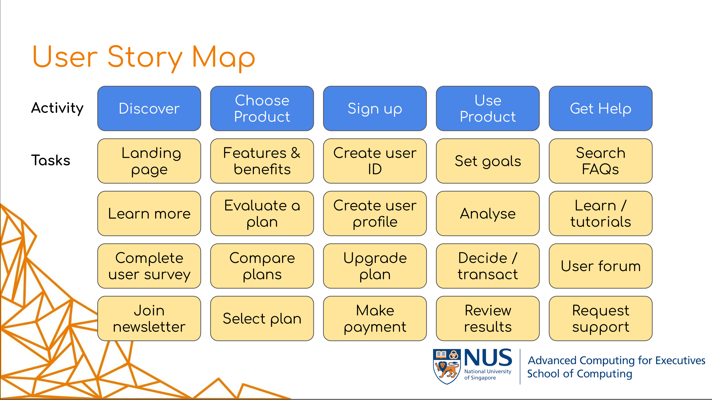
Service Platform Setup
For this Proof-of-Concept,
we will focus on the “Discovery” stage of user story.
User Process:
Students register with us.
Us respond to the enquiry (using the backend DB).
Students, for now will not be accessing their records in the frontend.
Frontend Design:
Typical sections to introduce the service.
Include a section to collect user information (data).
Backend Design:
For now, only the project team will access the backend database.
Notes:
https://github.com/jscheele/nusmoneysample

Slide 4
Demonstration

Slide 5
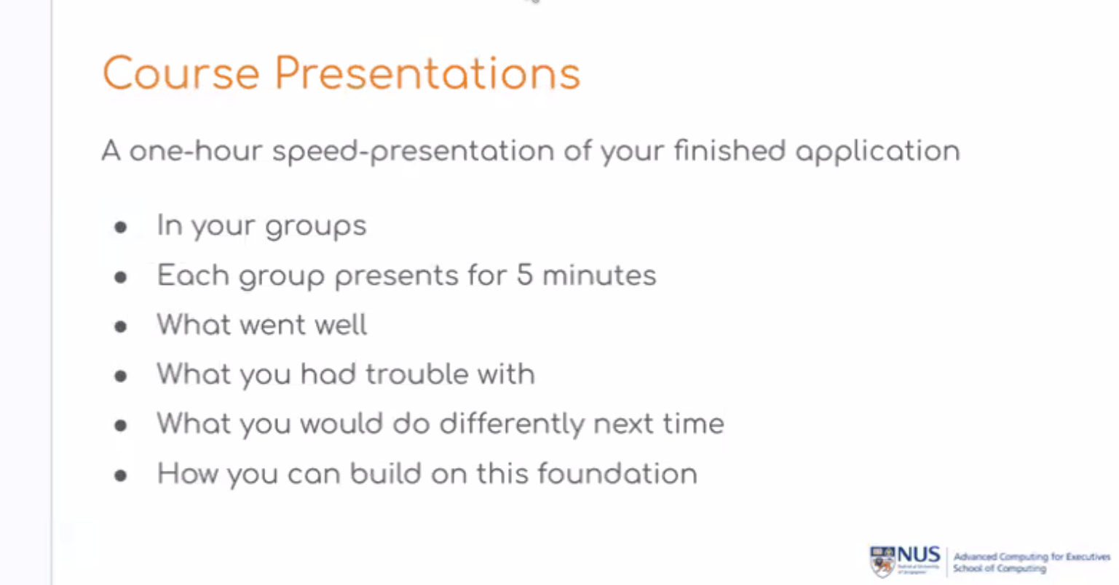
Lessons Learnt
What went well? | What we had trouble? | What would we do differently? | How can we build on this?
Our willingness to experiment. All members actively participate. | All members do not have coding, programming background. | Seek out reference materials online. Seek advice from classmates / colleagues. | Seek out opportunities to practice these knowledge / skills professionally.
?????
????

Slide 6
Thank You.

Slide 7
Frontend HTML
e.g. Financial HTML example
YAML
e.g. financial planning
(Documentation, not code)
Node JS
App.js
DB

